Slide 1
Week 3 AERO 222 Lab
Relevant notes for this week’s lab

Slide 2
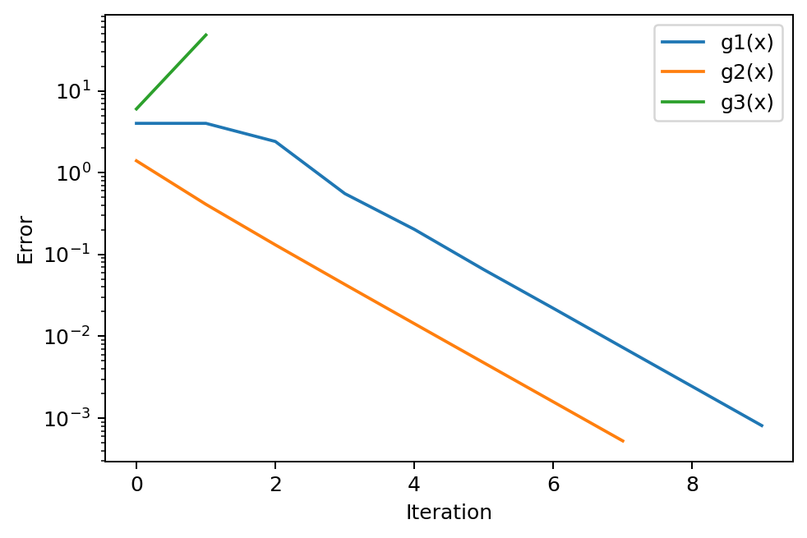
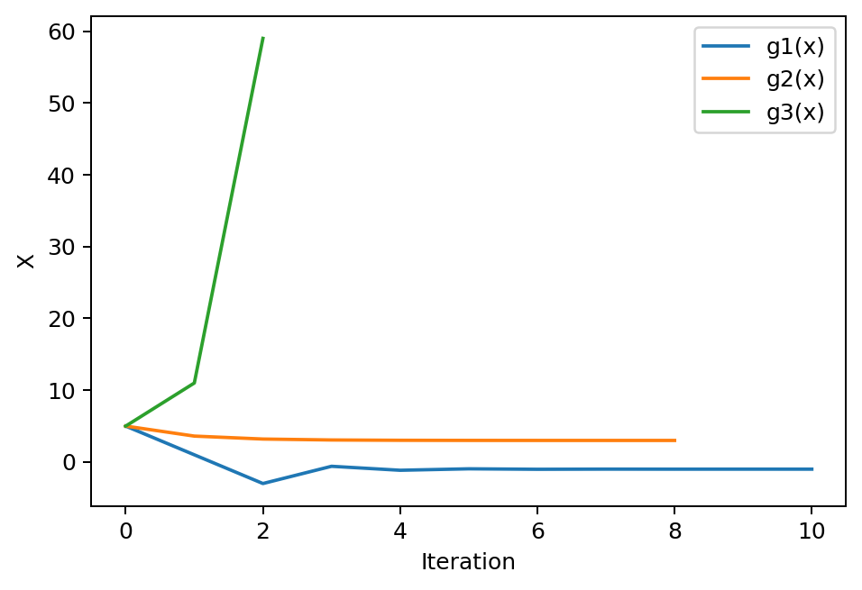
Problem Assignment
Given the equation x^2 – 3x – 5:
Find the roots using fixed point iteration starting at x = 5
Set ϵ = 0.001
There are 2 roots and 3 equations
2 functions converge to the 2 solutions
1 function diverges
Check to halt the process if the solution diverges
Plot the convergence of the errors and x

Slide 3
Fixed-point iteration: “x = g(x)” method

Slide 4
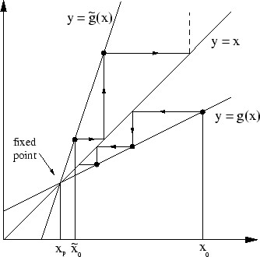
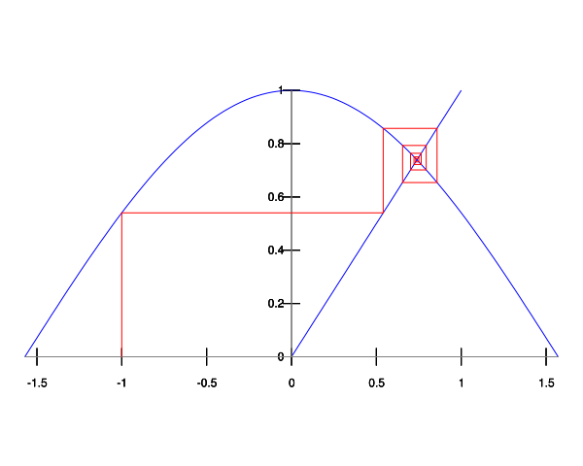
Go vertical to y = g(x)
Go horizontal to y = x

Slide 5
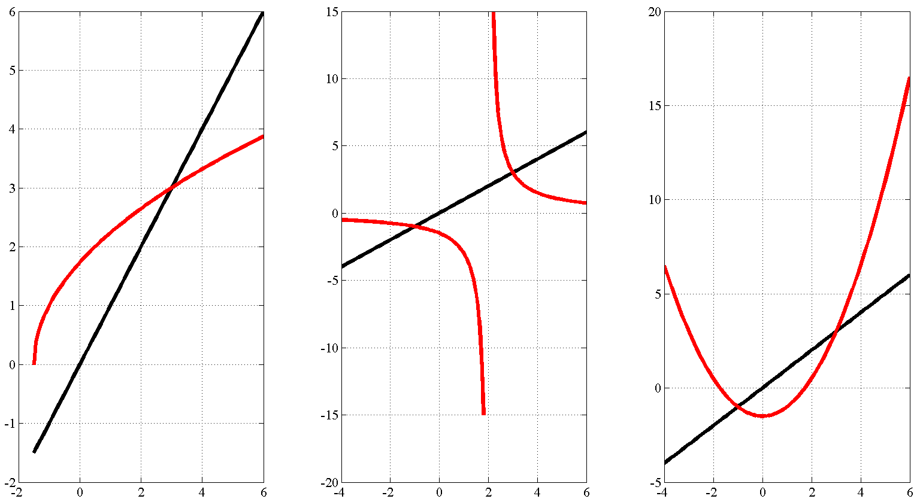
Fixed-point iteration: x = g(x) method
Convergence occurs where

Slide 6
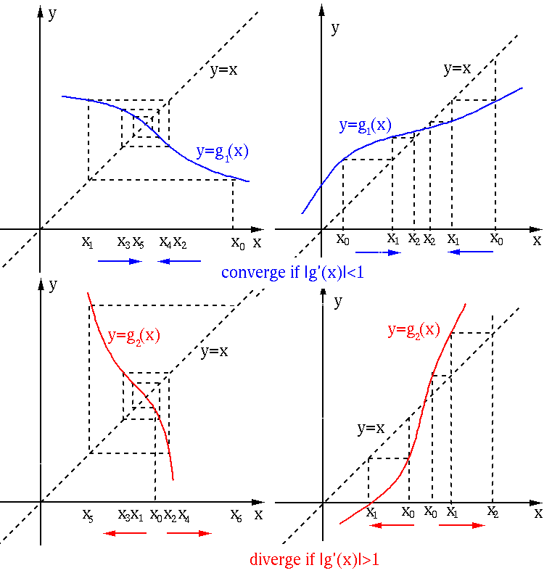
Keep doing convergence if
STOP doing convergence if

Slide 7
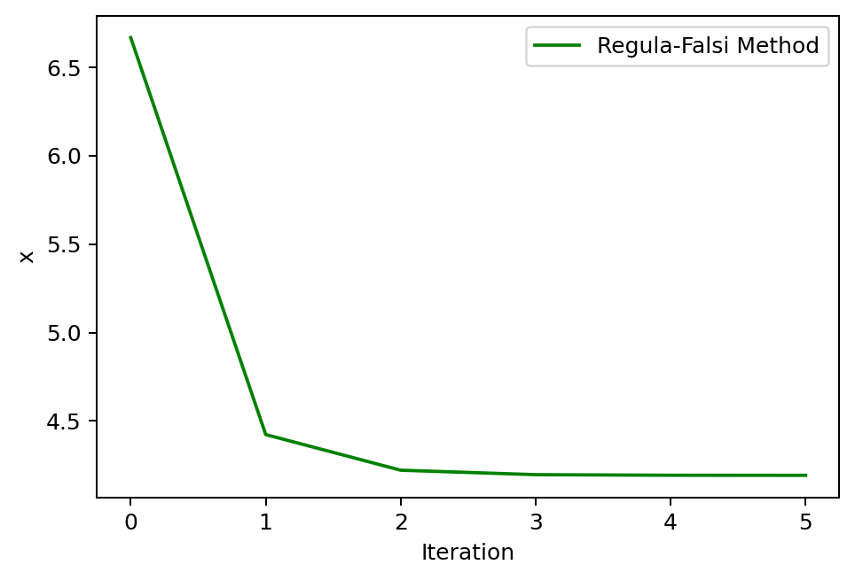
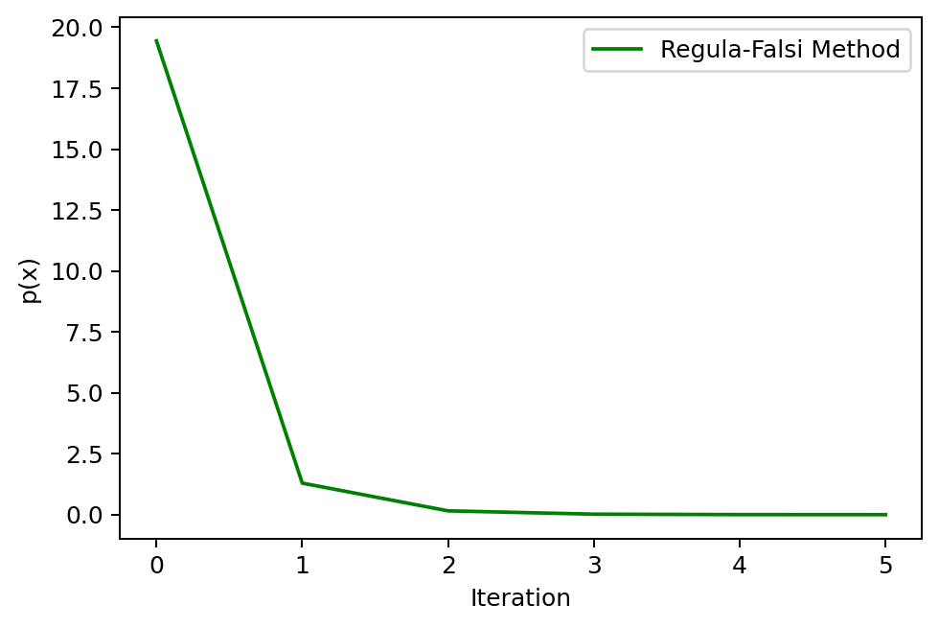
Problem 2
Given the equation x^2 – 3x – 5:
Find a roots using Regula-Falsi starting at x1 = -5, x2 = 5
Set ϵ = 0.001
Plot convergence of the residuals

Slide 8
Regula-Falsi
Regula-Falsi Method (False Position Method) is a linear interpolation method (fast) with convergence guaranteed (as bisection).
Algorithm Requirements
Bracketing required. Like bisection, it requires two points a and b for which f (a)⋅ f (b) < 0.
Convergence guaranteed. If the function f (x) is continuous on the interval [a,b] with f (a)⋅ f (b) < 0, the algorithm will converge to a solution.
Applicability limit. Secant and regula-falsi cannot be implemented to find a tangential root. That is for a function that is tangent to the x-axis (either positive or negative on both side of the root). For example f (x) = (x−3)², has a tangential root at x = 3.

Slide 9
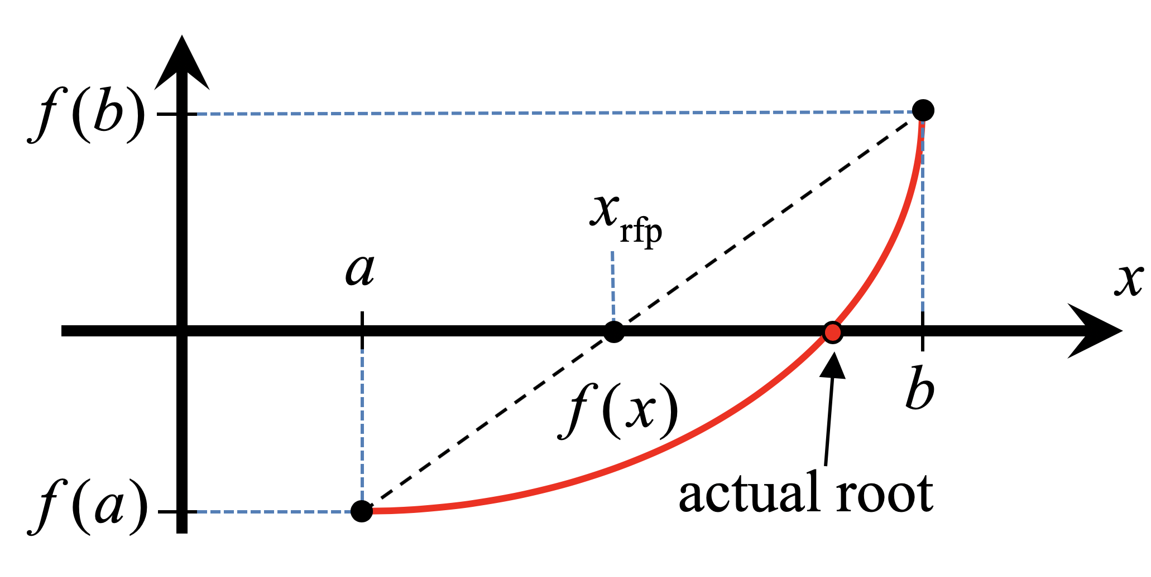

Regula-Falsi
1) Connect the points [a, f (a)] and [b, f (b)] with a straight line.
2) Find the Regula-Falsi Point (x_{rfp}) which is the solution to the linear equation connecting the endpoints.
Look at the sign of f (x_{rfp}):
while | f (x_{rfp}) | > ε then
if sign[ f (x_{rfp})] = sign [ f (a)] then set a = x_{rfp}
else set b = x_{rfp}
Equation of line:
$$\frac{y−f(b)}{f\left(b\right)−f(a)}=\frac{x−b}{b−a}$$
solving for $x_{rfp}$
$$\frac{0−f(b)}{f(b)−f(a)}=\frac{x_{rfp}−b}{b−a}$$
$$x_{rfp}=b−\frac{f(b)(b−a)}{f\left(b\right)−f(a)}$$

Slide 10
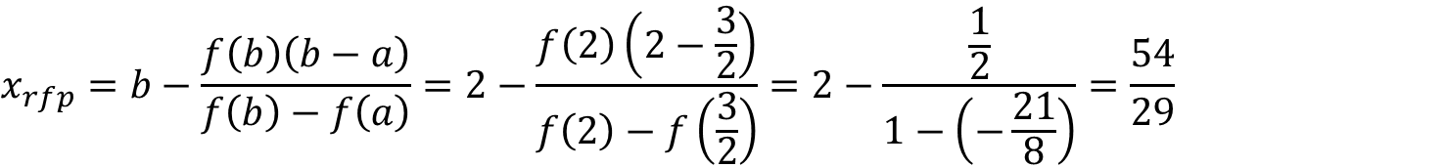
Regula-Falsi: Example
Let’s look for a solution to the equation f (x) = x³ − 2x − 3 = 0. On the interval [0, 2]. Consider a = 0 and b = 2. then f (0) f (2) = (−3)(1) = −3 < 0, → YES!
$$x_{rfp}=b−\frac{f\left(b\right)\left(b−a\right)}{f\left(b\right)−f\left(a\right)}=2−\frac{f\left(2\right)\left(2−0\right)}{f\left(2\right)−f\left(0\right)}=2−\frac{1\left(2\right)}{1−\left(−3\right)}=\frac{3}{2}$$
This is negative and we will make the a =3/2 and b is the same and apply the same thing to the interval [a=3/2, b=2].
$$f\left(x_{rfp}\right)=f\left(\frac{3}{2}\right)=−2.625$$
$$x_{rfp}=b−\frac{f\left(b\right)\left(b−a\right)}{f\left(b\right)−f\left(a\right)}=2−\frac{f\left(2\right)\left(2−\frac{3}{2}\right)}{f\left(2\right)−f\left(\frac{3}{2}\right)}=2−\frac{\frac{1}{2}}{1−\left(−\frac{21}{8}\right)}=\frac{54}{29}$$
Still negative and we will make the a =54/29 and b is the same and apply the same thing to the interval [54/29,2].
$$f\left(x_{rfp}\right)=f\left(\frac{54}{29}\right)=−0.26778$$

Slide 11
Stopping Conditions
Stopping condition is usually fixed to be a certain maximum number of iterations and
Standard Cauchy (residual or error). Consider a residuals tolerance, ε_{y}, and an error tolerance, ε_{x}.

Slide 12
Define your equations as functions
Test them out, make sure they return the correct values
Initialize your lists
Includes anything you need to track or plot
Determine your iterative
What error or an independent variable are you trying to converge?
Iterate to your solution
Keep track of which variables are inside your loop
What types of values are they?
Are you overwriting any values you need later?
End when stopping criteria is met
Plot your solution
Matplotlib.pyploy.plt
plt.plot(xList, yList (optional)) is the simplest plot
For logarithmic axis:
plt.loglog() plots both axis as log scale, plt.semilogx() plots the x axis as log scale, plt.semilogy() plots the y axis as log scale
Other tips:
Defined functions only track their specified inputs and outputs
If you redefine a variable later in your main script, it will not remember the previous value
If you redefine a single value in a list or array, it will update the array and keep the other array values
If you append a list, it will add the value to the end of the list
Use brackets for indices, parenthesis for calling functions and (if necessary) grouping/order of operations
Parenthesis immediately after a word will likely be treated as a function call
Square brackets immediately after a word will likely be treated as the index of a list or matrix
Someone, somewhere has probably run into the same problem before
Googling your errors or problems is a legitimate way to find programming solutions

